Slide 1
CAR PRICE PREDICTION PROJECT
SUBMITTED BY
Ankeet Sambyal

Slide 2

EXPLORATORY DATA ANALYSIS

Slide 3
STEPS
Creating my own dataset using web scraping
Importing the libraries needed for my project
Loading the dataset/Creating my dataframe
Checking the head of the dataset(first five rows)
Checking the shape of the dataset
Checking the datatypes
Checking for null values if any
These data analysis steps help us to get an overview of our dataset and also help us in our preprocessing of our data

Slide 4
DATA PREPROCESSING

Slide 5
STEPS AND DESCRIPTION
I have checked for null values and there are some null values present,I have removed it using SimpleImputer method
I have label encoded the object type columns in the dataset.
I have checked the correlation between dependant and independent variables using heatmap. I have seen most of the independent variables are correlated with each other and the target variable is positively correlated with a very few independent variables.
I have done some visualization using histogram.
I have checked outliers using boxplots ,but no outliers are present.
I also have checked for skewness in my data, but the skewness present is very negligible, so I don’t consider it.
I have splitted the dependant and independent variables into x and y.
I have scaled the data using StandardScaler method and made my data ready for model building.

Slide 6
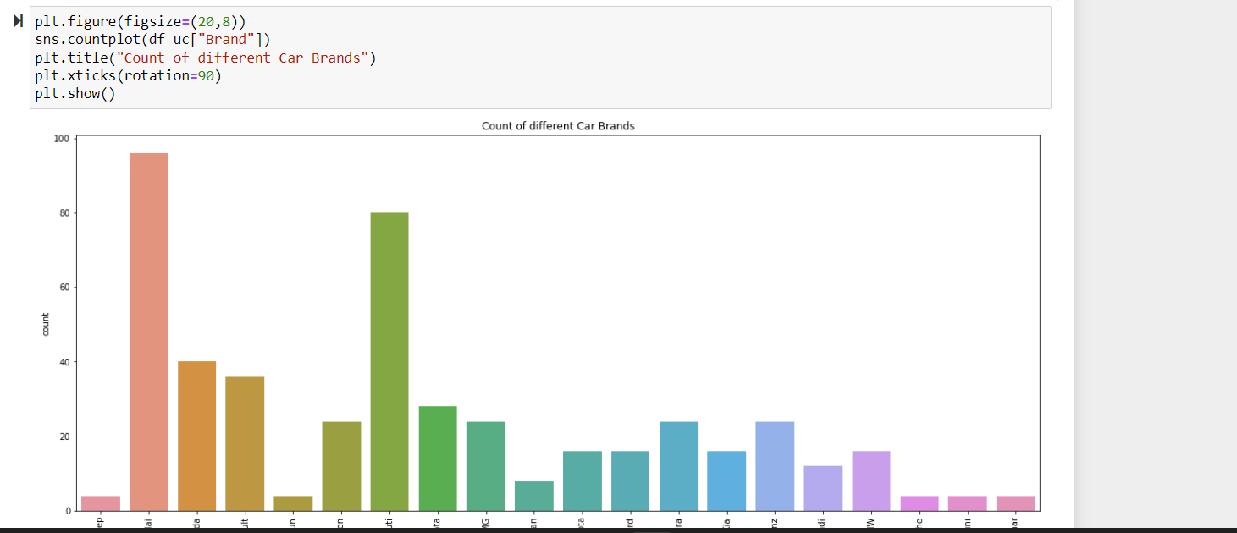

Slide 7
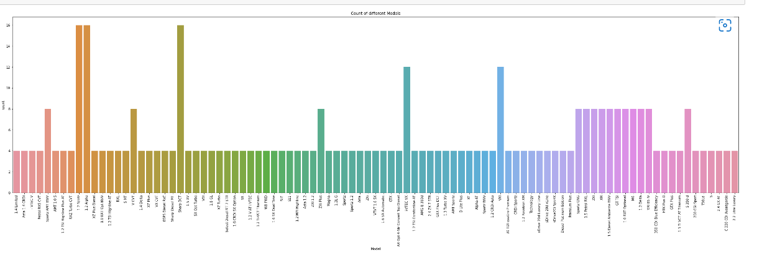

Slide 8
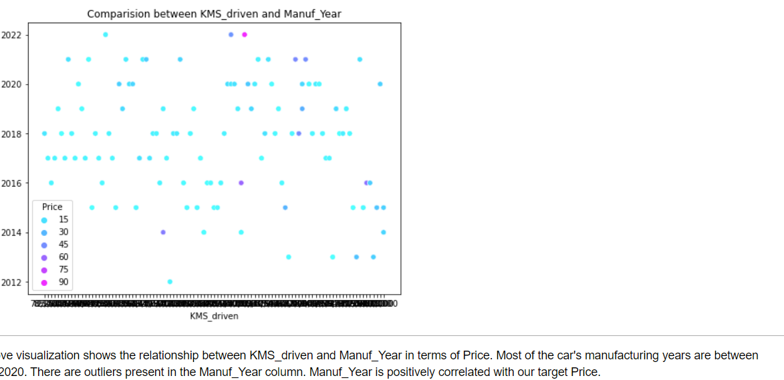

Slide 9

MODEL BUILDING

Slide 10
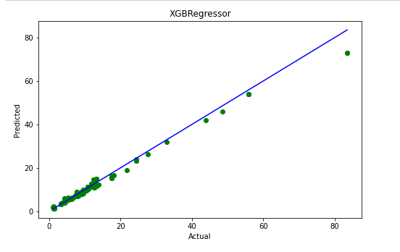
REGRESSION MODELS
For model building, I have used 5 Regressor models Decision Tree Regressor, Kneigh borsReg Linear Regression, Gradient Boost Regressor,Extratrees regressor,XGBoost regressor, out of whichXGB Regressor model is the best model for my dataset.
For better accuracy of the model, I have used hyper parameter tuning (Randomized SearchCV) and I have achieved 98% accuracy.

